Slide 1
Online Exams
Step By Step Procedure

Slide 2
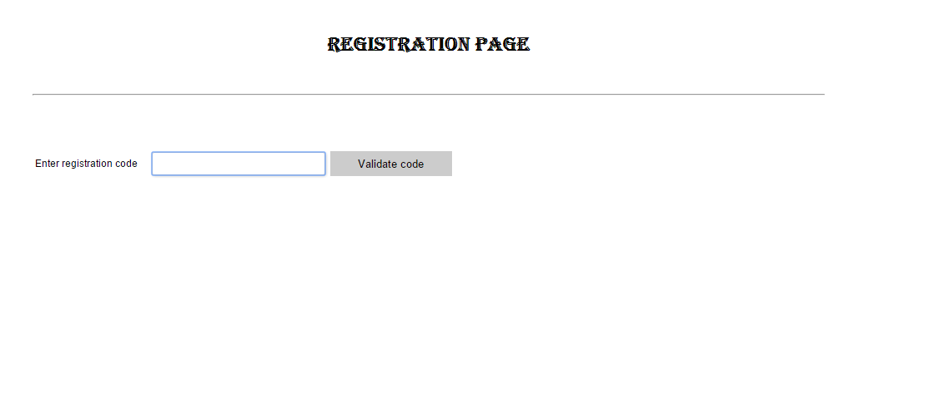
Step 1
Click on the registration link sent

Slide 3
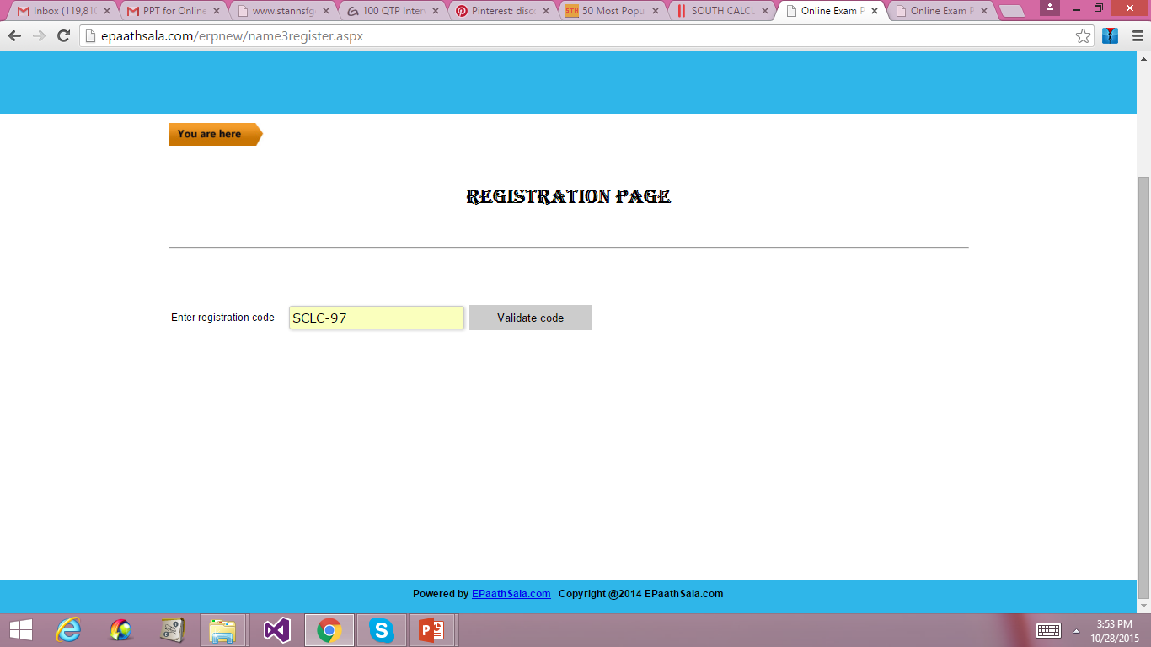
Step 2
Enter SCLC-97 as registration code and click on validate code

Slide 4
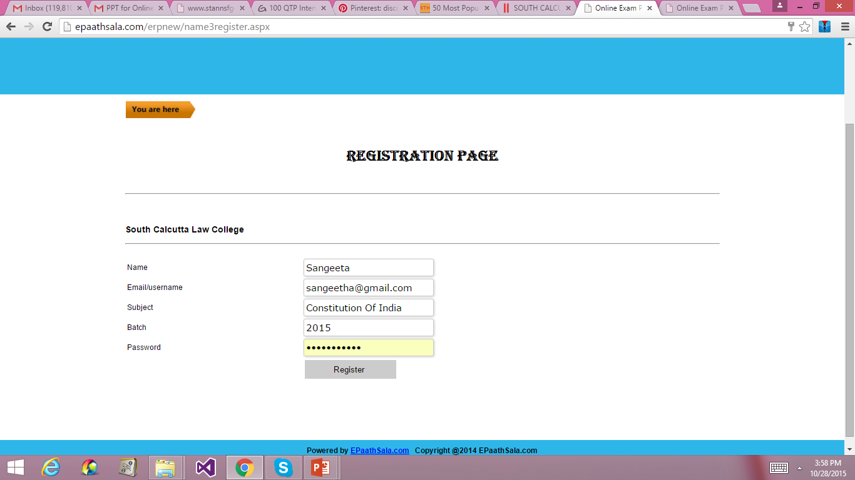
Step 3
Register by
Name: Your Name
Email/Username: Email ID which can be remembered
Subject: Enter subject name
Batch: Enter2015
Password: Enter password which can be remembered
Click on REGISTER

Slide 5
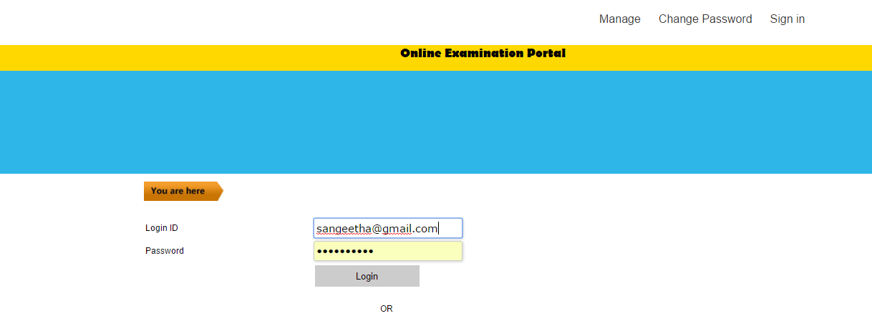
Step 4
Username: Enter username/Email provided in the previous page while registering
Password: Enter password provided in the previous page
Click on LOGIN

Slide 6
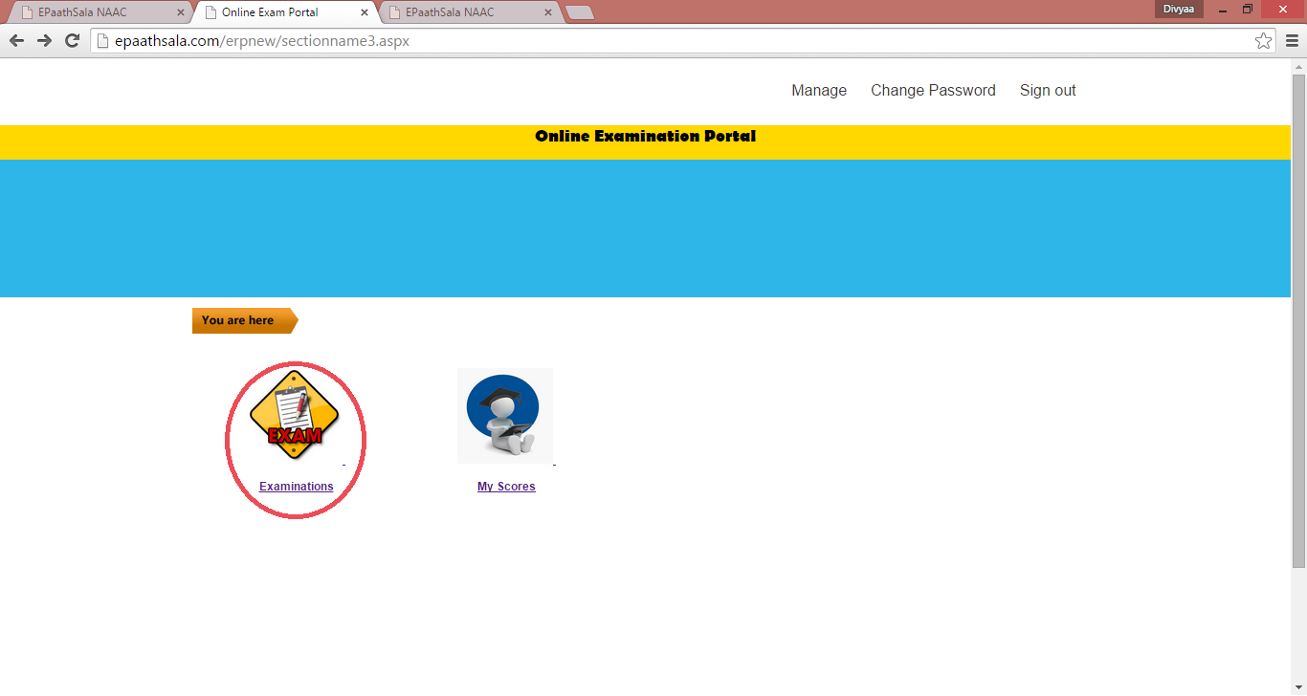
Step 5
Click on Examinations

Slide 7
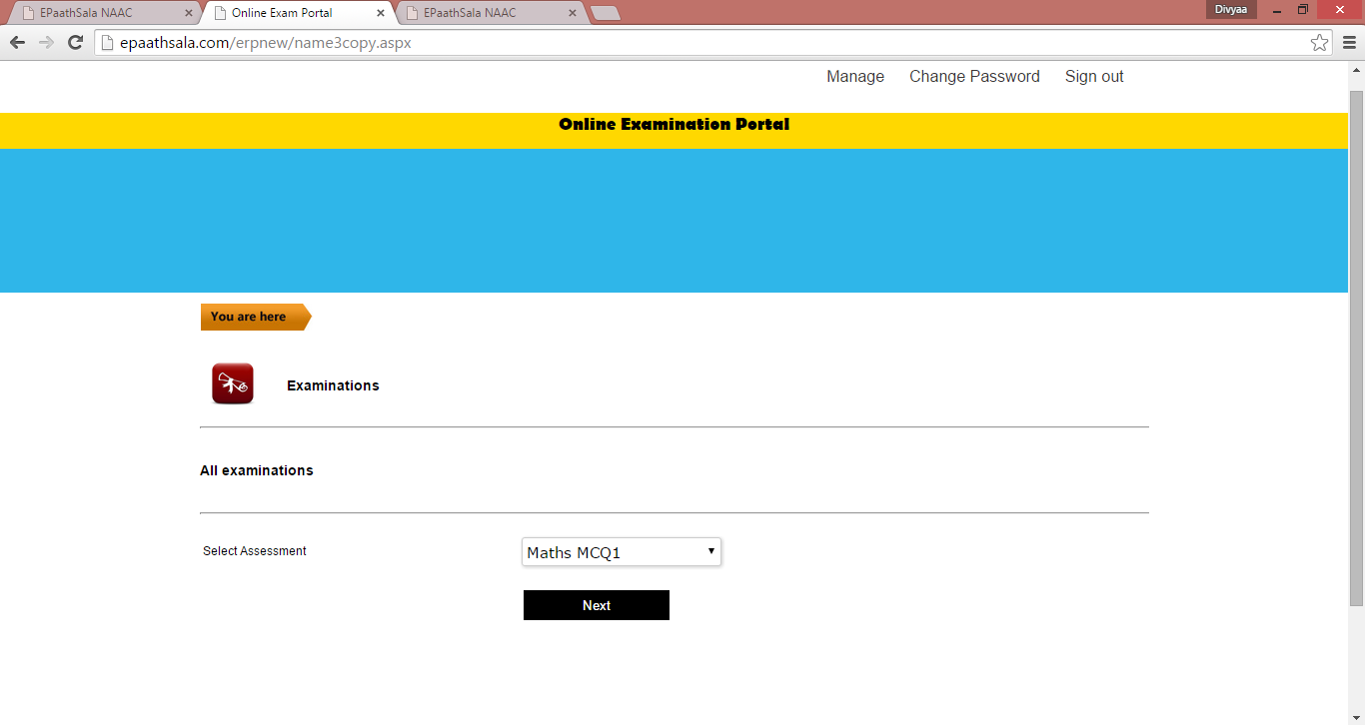
Step 6
Select the Subject from Select Assessment
Click on Next

Slide 8
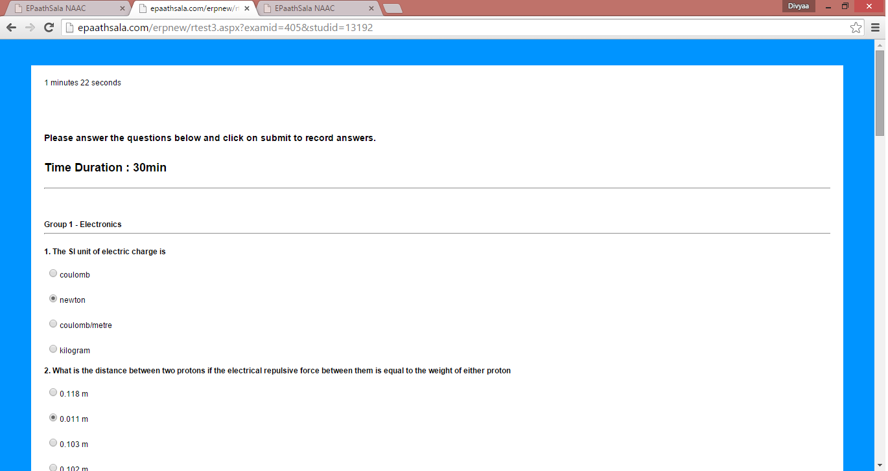
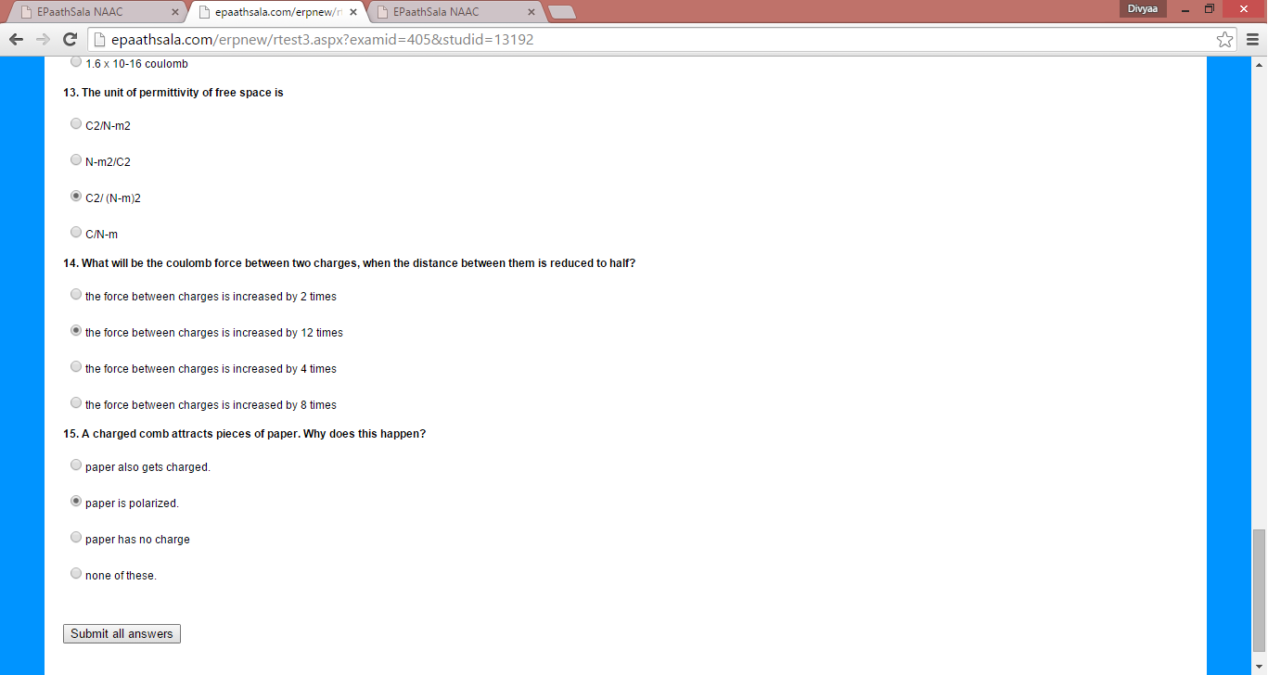
Step 7
Check mark the answers
Click on Submit all answers

Slide 9
Thank you

